Slide 1
Subway Line Background Agency
Owen Hanson - Evaluator
Staton Rosenblum - Gatekeeper
Evan Eldridge - Initiator
Tyler Allen - Arbitrator Riley Sallander - Coordinator

Slide 2
01
02
Table of contents
03
04
05
Intro to Problem
Findings
Interpretation
Recommendations
Further Analysis

Slide 3

NYC Subway Delays
The Problem
Frequent Delays: NYC subway delays disrupt commutes, increase rider frustration, and impact worker productivity.
Commuter Impact: Millions of daily riders face uncertainty about arrival times and potential missed connections.
Operational Inefficiencies: Unanticipated delays strain subway operators, reduce scheduling efficiency, and increase costs.

Slide 4
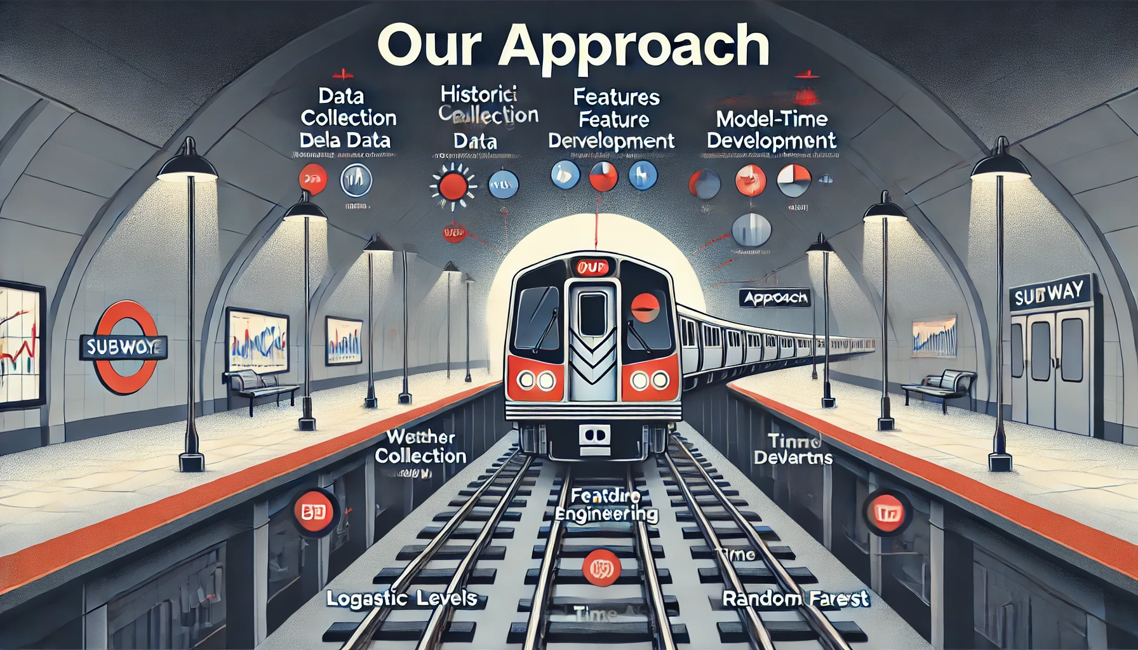
Our Approach
Predictive Model: Use machine learning models to forecast delays in real time.
Data Integration: Leverage historical delay records, weather conditions, time of day, and ridership data.
Outcome: Real-time alerts and route suggestions for NYC subway commuters to improve planning and reduce wait time

Slide 5
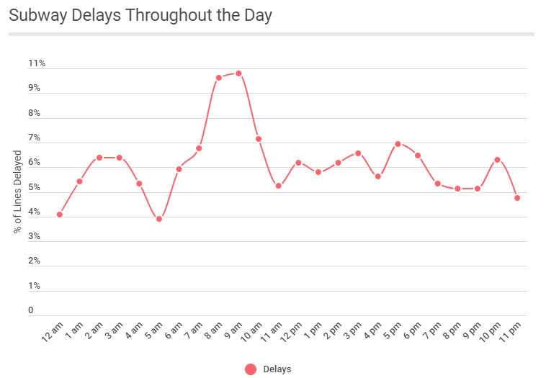

Slide 6
Subway Delays
Delay Category: After a delay occurs it is categorized into one of three groups: late, partial cancelation and full cancelation
Goal: Use pre-existing factors to predict what category of delay will occur when there is one. More importantly be able to predict cancellations as they are the most harmful to the subway and its riders.
Most Important Factors:
Delay Type: The reason for the delay such as customer issue, medical, police activity, etc.
Peak Hour: If the train is operating during peak time or not
Max Temp: The maximum temperature during the day
Best Model Results: Our decision tree model had a precision of 0.88 and a recall of 0.76 when predicting a cancelation on the subway when using the above factors.

Slide 7
On-Time Performance
OTP: On-Time Performance is an important monthly KPI developed by MTA to monitor whether each line met its target regarding delays
Goal:
To predict whether an individual subway line will meet its OTP target for the month, using other KPIs and train/station infrastructure information.
Most important variables in classifying OTP were:
Elevator Availability, Escalator Availability, and Employee Lost Time Rate*.
Best Model Results:
The classification model with the highest accuracy to predict monthly OTP per line was KNN with approximately 79% Accuracy, when using the above variables, as well as Customer Injury Rate and Monthly Total Riders
What does this mean? And how can we use this information to improve the New York Subway System?
* Employee Lost Time Rate: the percentage of total working hours lost due to employee absences

Slide 8
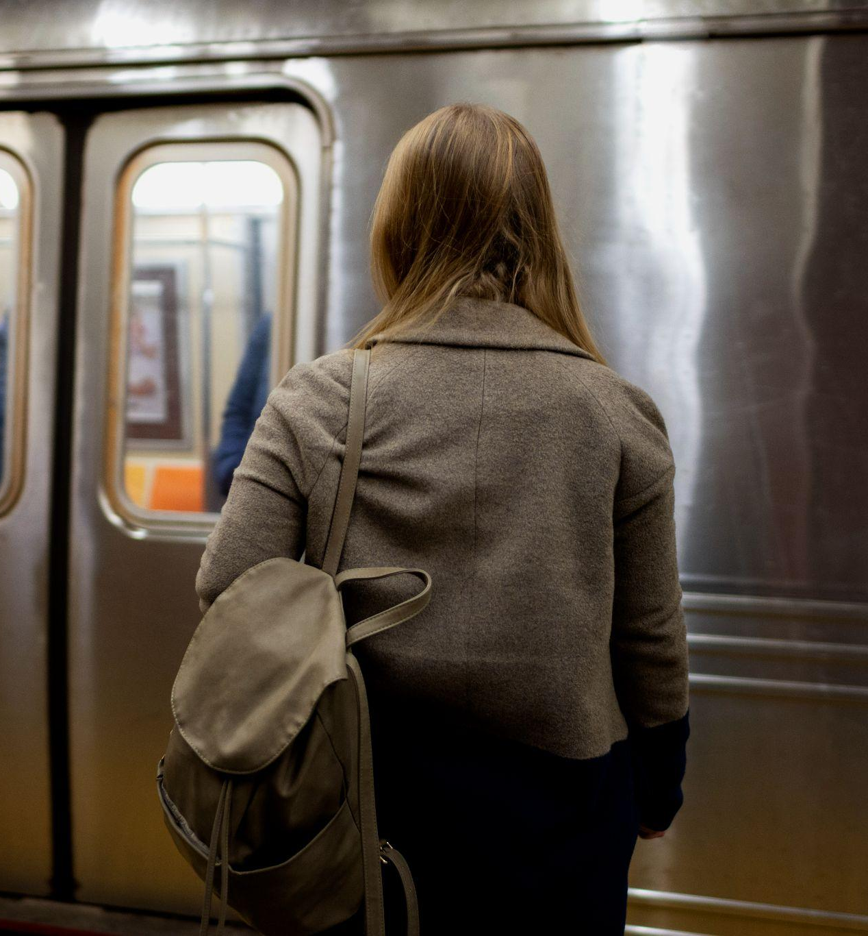
Recommendations
Prioritize maintenance and availability of infrastructure
Focus funding on ensuring elevator and escalator availability (key predictors of OTP)
Allocate resources to improve workforce efficiency and safety
Invest in employee well-being, training, and safety protocols
Be proactive in limiting significant factors contributing to delays:
Peak hour: increase staffing and the amount of trains during this period
Use the decision tree model to predict future cancellations

Slide 9
Further Analysis
Causal Analysis
Impact of Key Factors: Use casual models (DiDs) to quantify how weather, rush hour, and policy changes impact delays
Policy Change Analysis: Measure the effect of operational changes (e.g., increased staffing) on subway performance
Forecasting and Time Series Analysis
Seasonal & Event Analysis: Analyze how special events (like parades) and seasonal changes (winter storms) impact delays
Equity & Accessibility Analysis
Equitable Service Analysis: Identify whether certain neighbors (especially low income) experience more delays
Accessibility Insights: Measure the impact of delays on riders with mobility challenges, supporting more inclusive planning of the subways

